Slide 1


Slide 2
Introduction
Databases help us model the relationships between datasets
Spreadsheets are not databases (please don’t call them that!)
There are many database engines
(MySQL, SQL Server, Oracle, Postgres, etc.)
I’m good at SQL Server so we’re using that
SQL Server Express is free and really quite powerful
www.microsoft.com/en-us/server-cloud/products/sql-server-editions/sql-server-express.aspx
Just click ‘Next’ a few times and you’ll probably be alright

Slide 3
Where do databases fit in?
They can be standalone and used for ad hoc queries (this lecture)
They can be a layer in a more complex application:
GUI
Web service
Business logic
Object-relational mapper
Ad hoc queries
Database

Slide 4
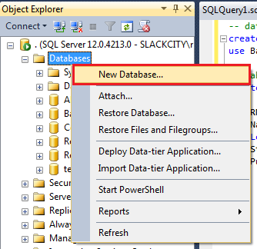
Creating a database
SQL
Management Studio
-- (re)create and use a database
if exists (select * from sysdatabases where Name = 'Basics')
drop database Basics;
create database Basics;
use Basics;

Slide 5
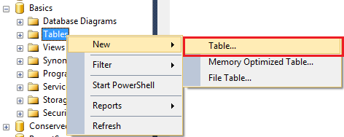
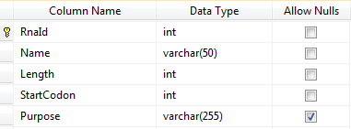
Creating a table to hold rows of data
SQL
Management Studio
-- create a table
create table RNA
(
RnaId int identity(1,1) primary key,
Name varchar(50) not null,
Length int not null,
StartCodon int not null,
Purpose varchar(255) null
);

Slide 6
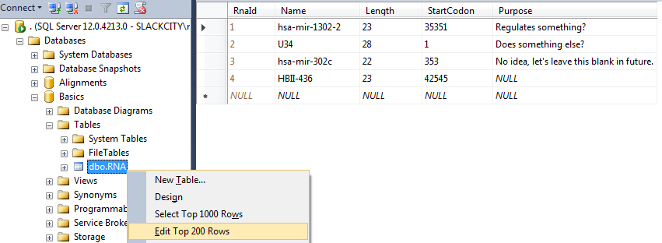
Table contents and CRUD
Create, Retrieve, Update and Delete
This covers pretty much everything you do to data

Slide 7
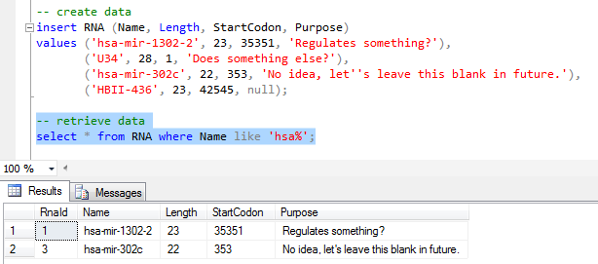
Table contents and CRUD
Creating and retrieving data
Tip: select a part of the script and hit F5 to run that bit alone

Slide 8
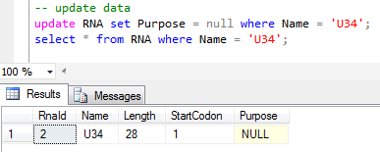
Table contents and CRUD
Updating data

Slide 9
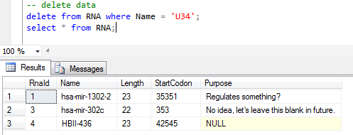
Table contents and CRUD
Deleting data

Slide 10
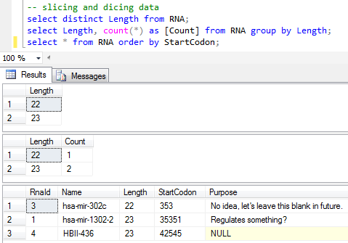
Slicing and dicing
Three statements and three result sets:

Slide 11
Primary keys
Each record should have a way of uniquely identifying it
-- create a table
create table RNA
(
RnaId int identity(1,1) primary key,
Name varchar(50) not null,
Length int not null,
StartCodon int not null,
Purpose varchar(255) null
);
Records in other tables can be unambiguously linked to a record in this table (we’ll see how in a moment)

Slide 12
Natural or arbitrary keys?
You could use the RNA name as the key instead…
What if you want to change the name but it’s been used elsewhere?
You’d have to find and change everywhere else the name has been used
You’d have to do this update everywhere simultaneously…
Don’t do it! Use auto-incrementing integers. Always.
Predictable Id mechanism
Field data can be edited without breaking links
The ‘payload’ fields can anyway be set to be unique if required
This argument was settled a long time ago

Slide 13
Foreign keys
A foreign key field is used to relate one table’s data to another’s
Referential integrity: the database engine will enforce these links
This is one of the main advantages of relational databases
But first, we need another table:
-- another table
create table Chromosomes
(
ChromosomeId int identity(1,1) primary key,
Name varchar(50)
);

Slide 14
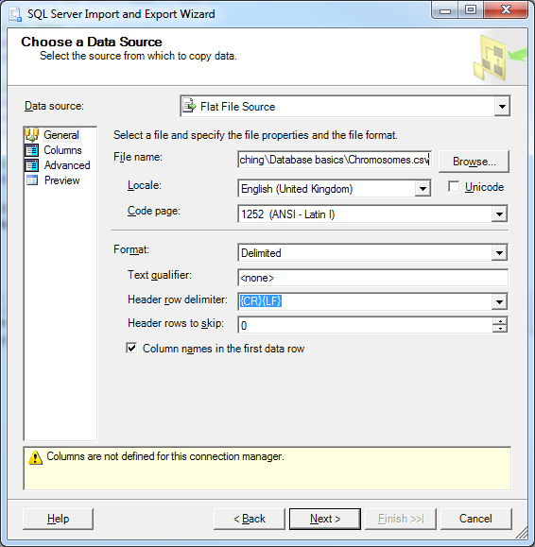
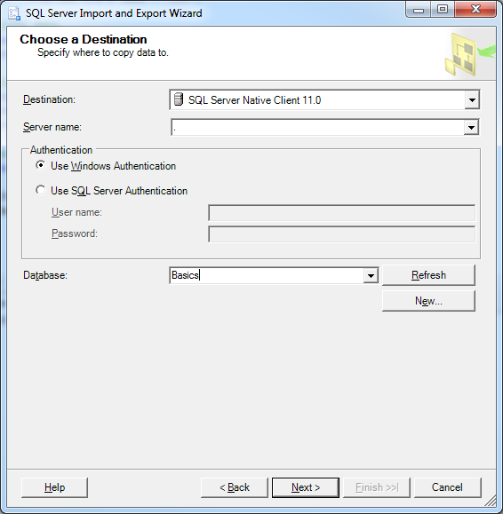
Digression: Importing data
Right-click on the database, choose Tasks, Import Data
The source and destination matter most, just click ‘Next’ for the rest

Slide 15
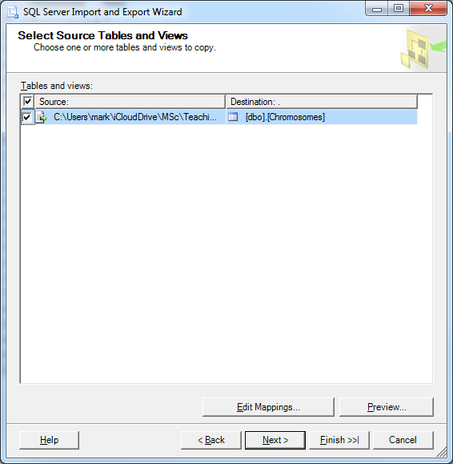
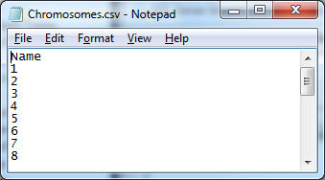
Digression: Still importing data
SQL Server has spotted that we have a table with the right name
It also maps to the right field because we named everything sensibly

Slide 16
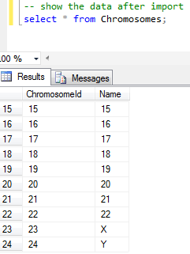
Digression: Imported data
The CSV has imported to the correct field as well
SQL Server assigned Id values to each record

Slide 17
Foreign keys continued
We need a link field in RNA to match the Id field in Chromosomes:
-- add a link field
alter table RNA add ChromosomeId int not null default(1);
We relate the two tables with a ‘foreign key constraint’:
-- create the foreign key
alter table RNA add constraint FK_RNA_Chromosomes
foreign key (ChromosomeId)
references Chromosomes (ChromosomeId)
on delete cascade;

Slide 18
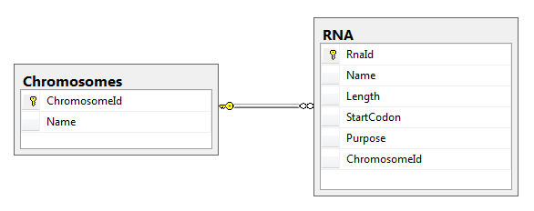
Digression: database diagrams
Right-click on Database Diagrams and New Database Diagram
Select both tables and click Add and then Close

Slide 19
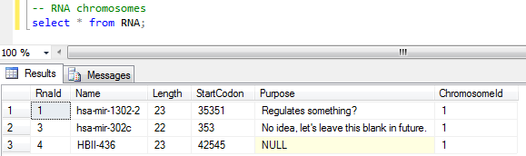
Foreign keys
Why did we just do all this?
The RNAs are now all associated with a chromosome
RNAs have to have a chromosome (thanks to referential integrity)
Chromosomes can have associated RNAs (but they don’t have to)
This is a one-to-many relationship

Slide 20
Joins
Join relate data from different tables together
Takes into account the relationships between the tables
There are various types:
Inner joins – results have values in both tables
Left outer joins – results have values in at least the left hand table
Cross joins, full outer joins, etc. – you’ll hardly ever need these

Slide 21
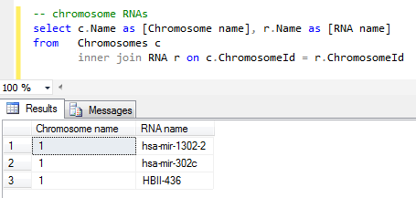
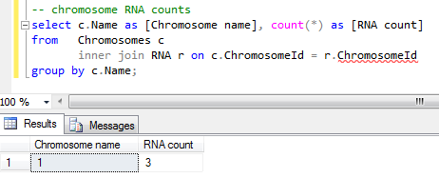
Inner joins
Combines records from two tables using a common field
Only common values that are in both tables participate

Slide 22
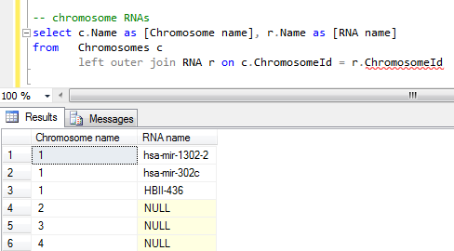
Left outer joins
Combines records from two tables using a common field (like inner)
Common values that are in left table are always present
Missing values in right table are null

Slide 23
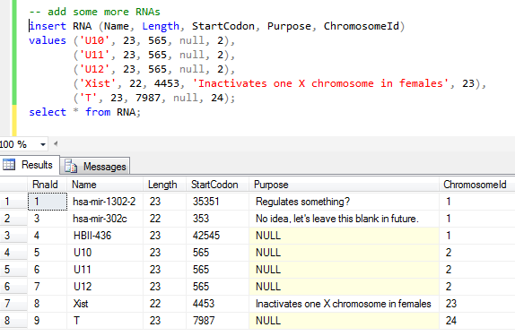
Putting it all together
Add some more RNA

Slide 24
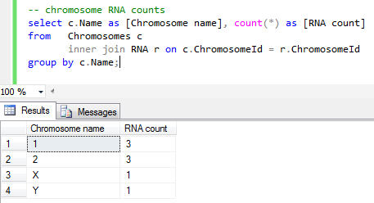
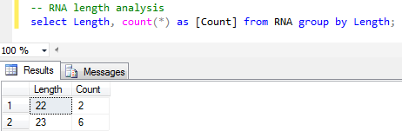
Putting it all together
Chromosome RNA counting and length analysis

Slide 25
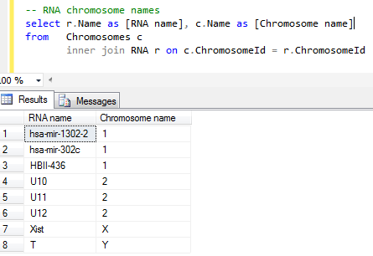
Putting it all together
RNA chromosome names

Slide 26
Summary
Create databases and tables
CRUD
Import data
Create relationships between data
Exploit those relationships to answer questions about the data
Referential integrity prevents the data from becoming malformed

Slide 27
Next steps (next lecture?)

Slide 28
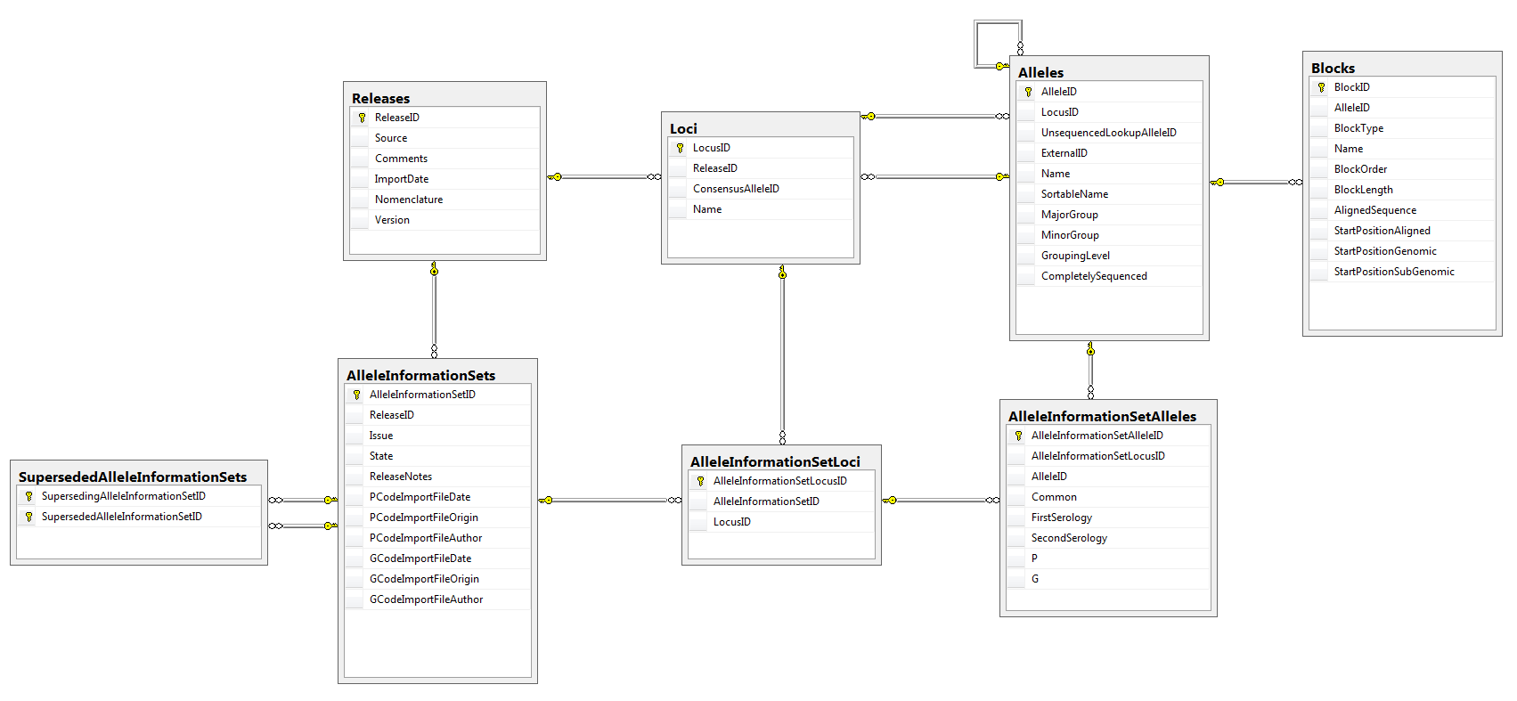
Real world example 1

Slide 29
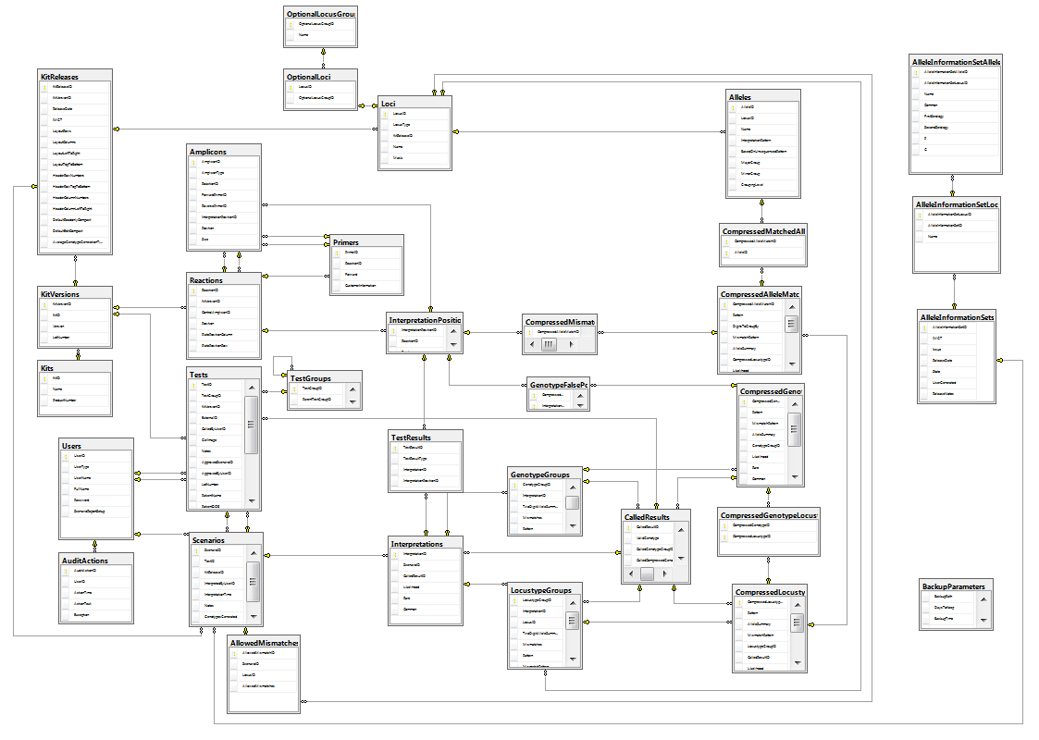
Real world example 2

